Slide 1
Object-Oriented
Software Engineering
B10523018 Jenny
B10523019 Jason
B10523020 Kendy
B10523021 Johnny
B10523022 Howard
B10523028 James
B10523029 Timothy
B10523030 Jerry
B10523032 Xavier
B10523033 Alex
Group5

Slide 2
Contents
Snapshots of the result
The figure of WMC, DIT, NOC, CBO, RFC, LCOM
Junit test
While Box
Black Box
Invocation chains of the design

Slide 3
Snapshots of the result

Slide 4
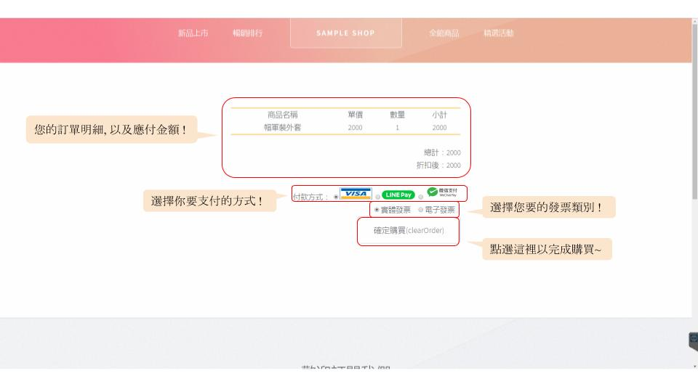

Slide 5
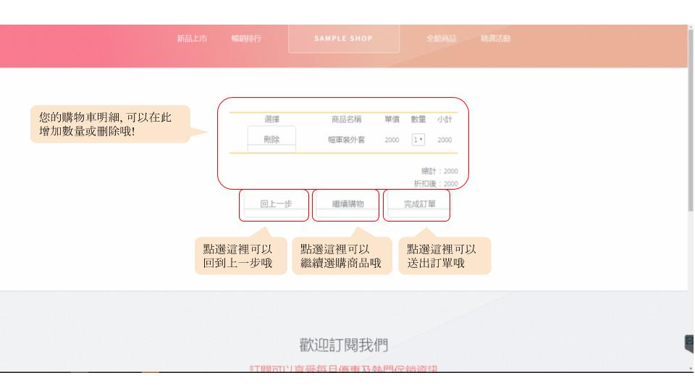

Slide 6
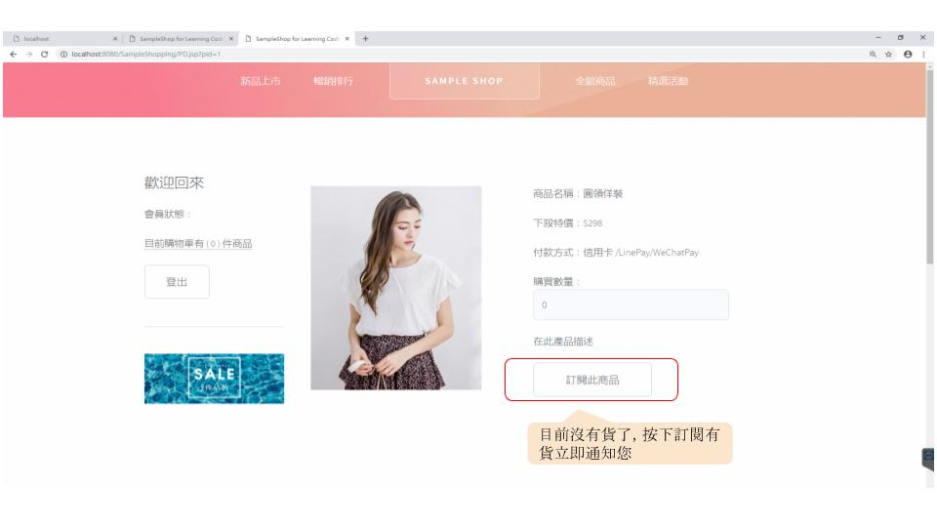

Slide 7
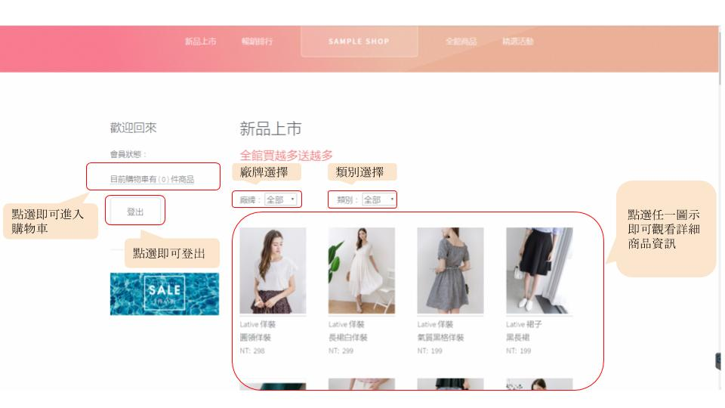

Slide 8
The figure of
WMC, DIT, NOC, CBO, RFC, LCOM

Slide 9
WMC

Slide 10
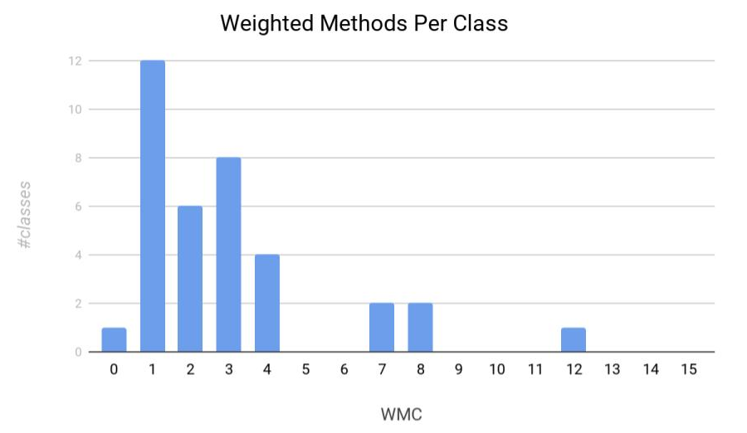

Slide 11
DIT

Slide 12
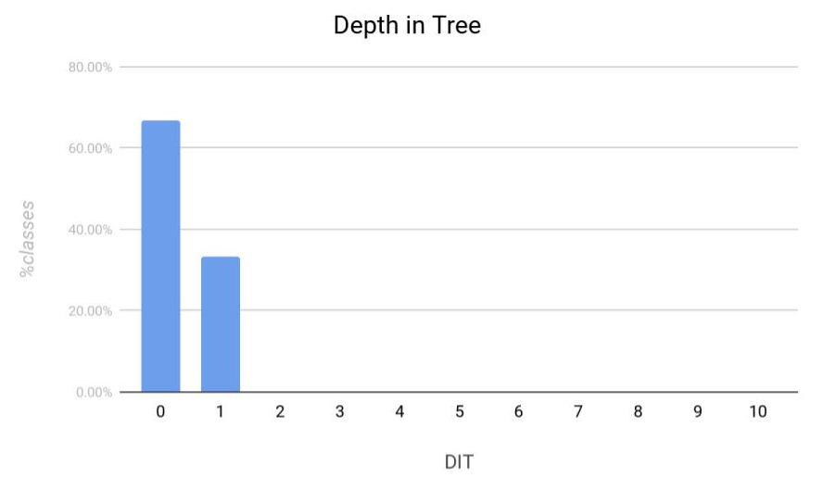

Slide 13
NOC

Slide 14
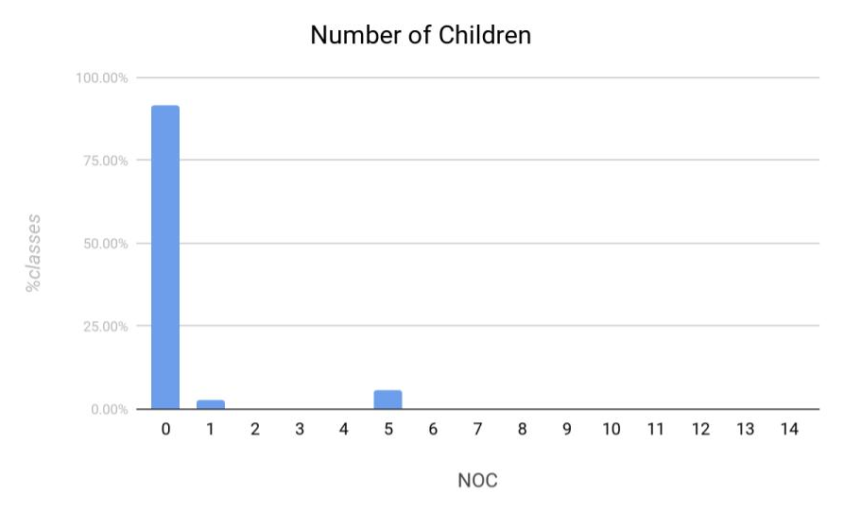

Slide 15
CBO

Slide 16
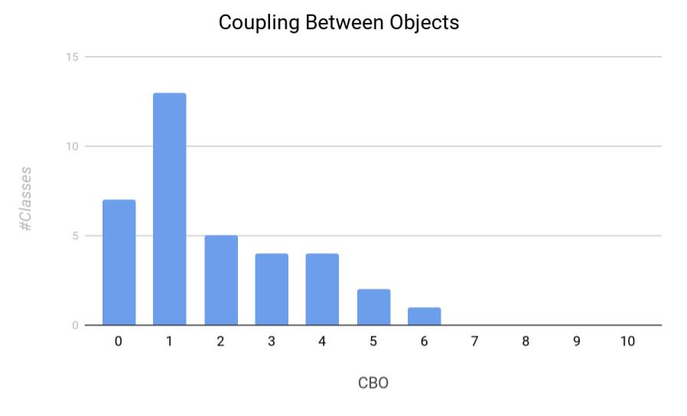

Slide 17
RFC

Slide 18
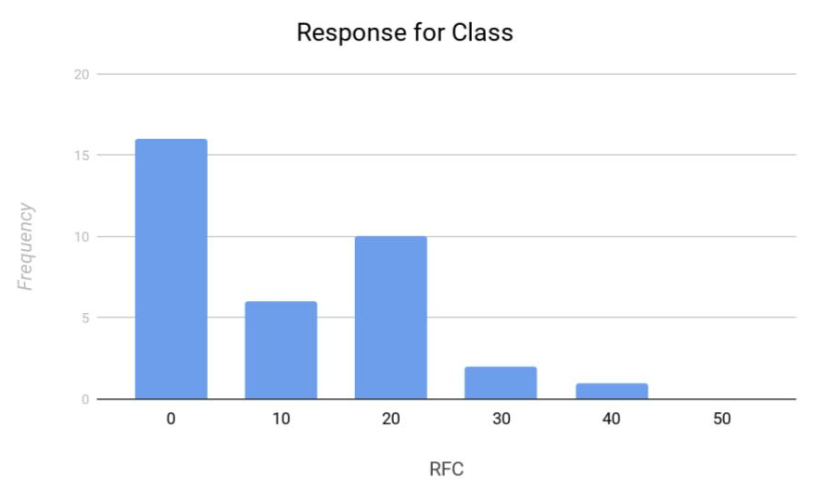

Slide 19
LCOM

Slide 20
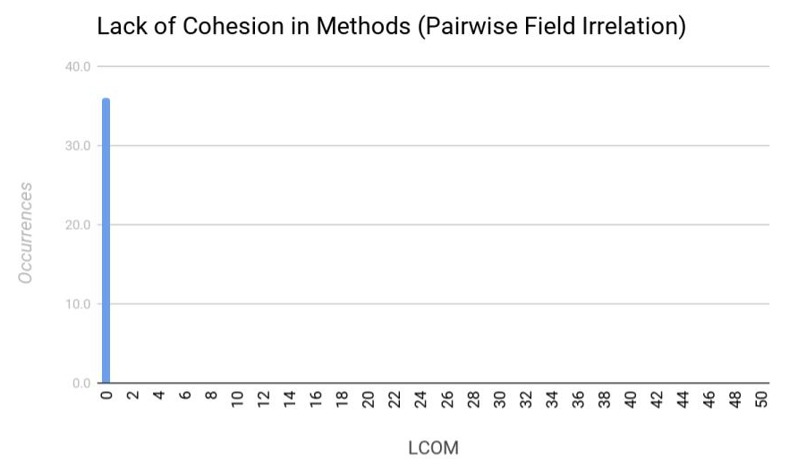

Slide 21
Junit test

Slide 22
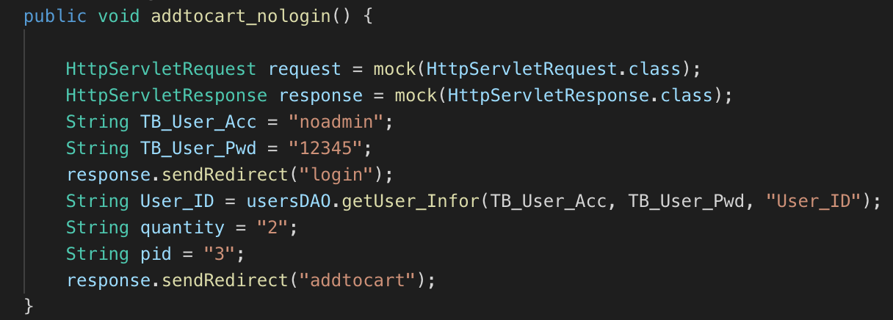

Slide 23
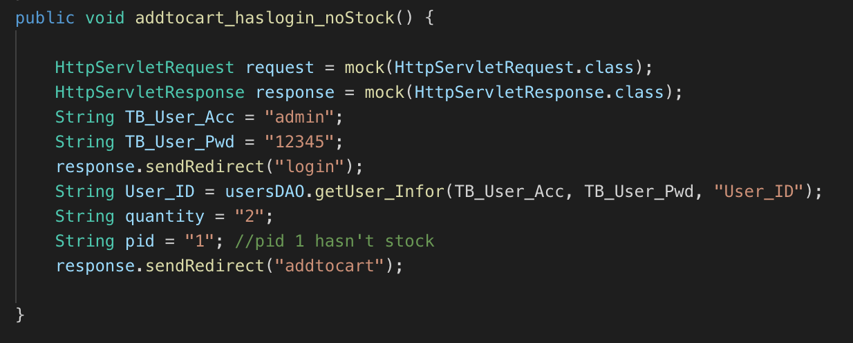

Slide 24
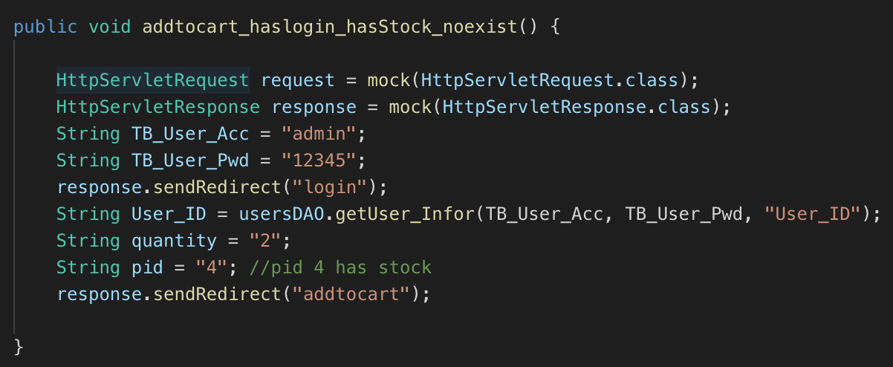

Slide 25
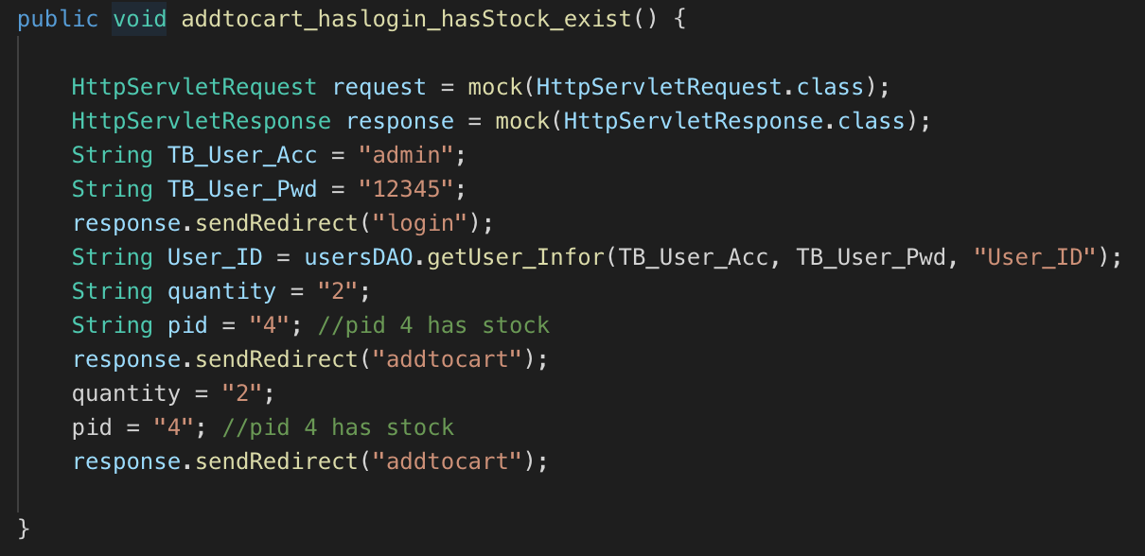

Slide 26
While Box

Slide 27
Flow graph

Slide 28
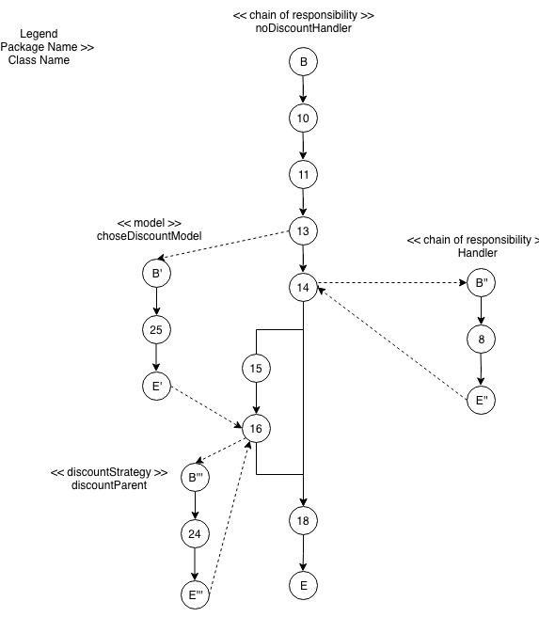

Slide 29
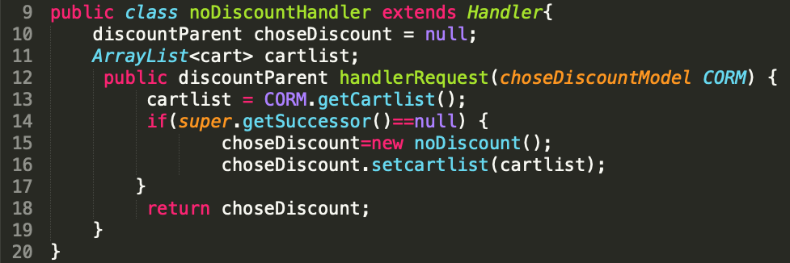

Slide 30
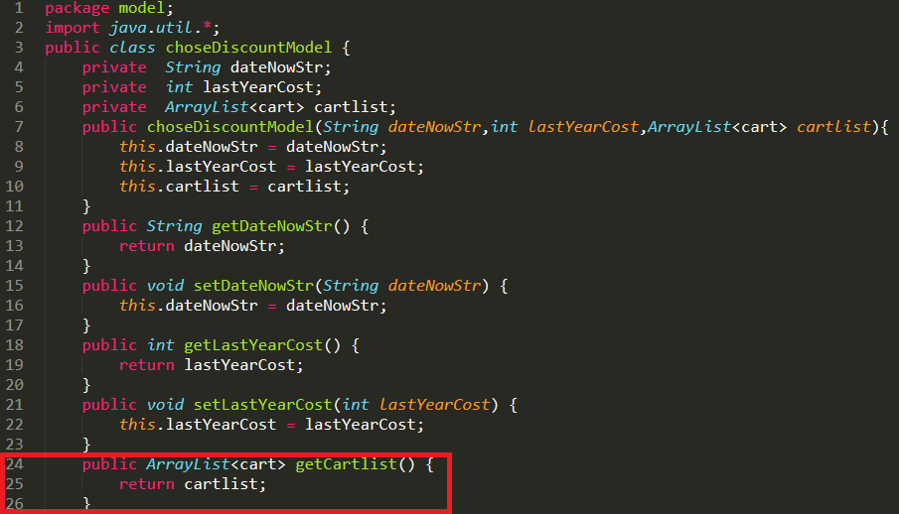

Slide 31
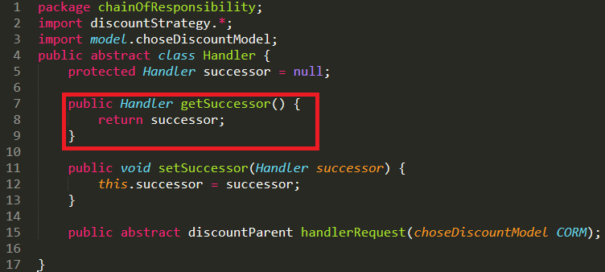

Slide 32
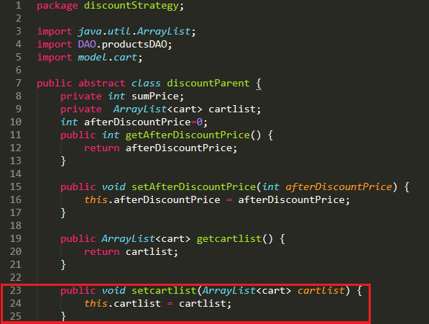

Slide 33
Basis Paths

Slide 35
Path1: B 10 11 13 14 15 16 18 E
Path2: B 10 11 13 14 18 E

Slide 36
Black Box

Slide 37
Cause-Effect Testing

Slide 38
 | 1 | 2 | 3 | 4 | 5 | 6 | 7 | 8
login | N | N | N | N | Y | Y | Y | Y
in of stock | N | N | Y | Y | N | N | Y | Y
item(s) was already in your Cart | N | Y | N | Y | N | Y | N | Y
case count | 1 | 1 | 1 | 1 | 1 | 1 | 1 | 1
add successfully |  |  |  |  |  |  | X
add-fail | X | X | X | X | X | X |  | X

Slide 39
 | 1 | 2 | 3 | 4
login | N | Y | Y | Y
in of stock | - | N | Y | Y
same item(s) is chosen | - | - | N | Y
case count | 4 | 2 | 1 | 1
add successfully |  |  | X
add-fail | X | X |  | X

Slide 40
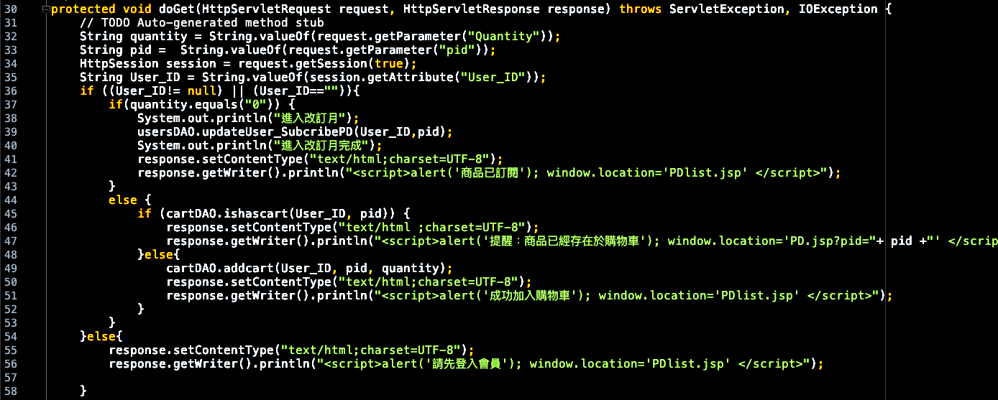

Slide 41
Boundary Value Analysis

Slide 42
No. | # of item(s) in stock | output
1 | -1 | Error
2 | 0 | Message := ‘Run out of stock’
3 | 1 | add successfully
4 | 4 | add successfully
5 | 5 | add successfully
6 | 6 | Error
7 | [0,5] | add successfully

Slide 43
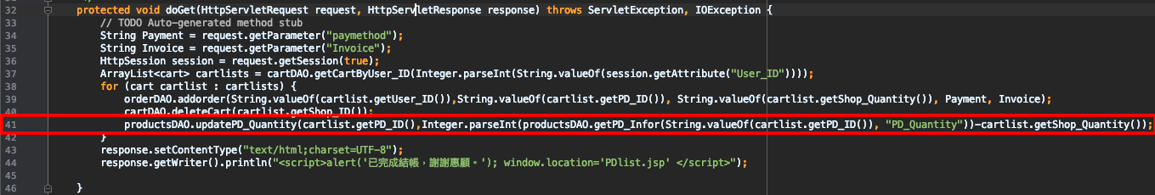

Slide 44
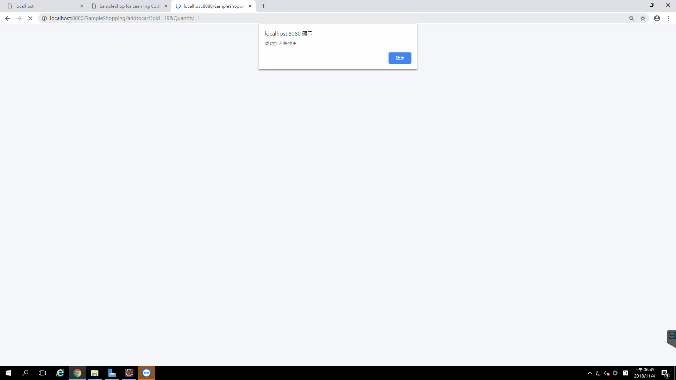

Slide 45
Deriving Test Cases

Slide 46
m = # in stock before Customer’s choice
n = # in stock after checkout completed
Stock = 1, 2, … n , n<=m
case 1: n<=0
Input : Stock = (1,2,3,...m)
expected output : Message := ‘Run out of stock’
case 2: n=1 (After checkout completed, only one item in stock)
Input : Stock=(1,2,3,...m)
expected output: Stock= (1).
case 3.1: m>n (After checkout completed, the remainder of the stock is greater than one item)
Input : Stock=(1, 2, 3,...m)
expected output: (1, 2).
case 3.2: m=n (An order isn’t completed for some unknown reason)
Input : Stock=(1,2,3,...m)
expected output: Stock=(1,2,3,...n).

Slide 47
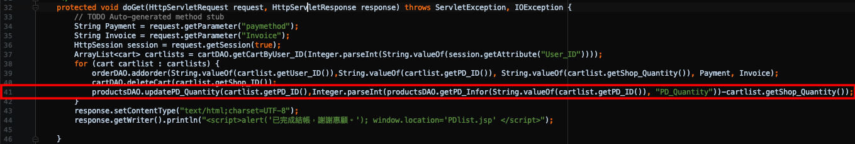

Slide 48
Invocation chains

Slide 49
public class addtocart extends HttpServlet
doGet(HttpServletRequest request, HttpServletResponse response)→ request.getParameter("Quantity")→ String.valueOf(request.getParameter("Quantity")) | 2
doGet(HttpServletRequest request, HttpServletResponse response)→request.getParameter("pid")→ String.valueOf(request.getParameter("pid")) | 2
doGet(HttpServletRequest request, HttpServletResponse response)→request.getSession(true) | 1
doGet(HttpServletRequest request, HttpServletResponse response)→session.getAttribute("User_ID"))→ String.valueOf(session.getAttribute("User_ID")) | 2
doGet(HttpServletRequest request, HttpServletResponse response)→usersDAO.updateUser_SubcribePD(User_ID,pid) | 1
doGet(HttpServletRequest request, HttpServletResponse response)→response.setContentType("text/html;charset=UTF-8") | 1

Slide 50
doGet(HttpServletRequest request, HttpServletResponse response)→response.getWriter().println("<script>alert('商品已訂閱'); window.location='PDlist.jsp' </script>") | 1
doGet(HttpServletRequest request, HttpServletResponse response)→cartDAO.ishascart(User_ID, pid)→ response.setContentType("text/html ;charset=UTF-8")→response.getWriter().println("<script>alert('提醒：商品已經存在於購物車');window.location='PD.jsp?pid="+ pid +"' </script>") | 3
doGet(HttpServletRequest request, HttpServletResponse response)→cartDAO.ishascart(User_ID, pid)→cartDAO.addcart(User_ID, pid, quantity)→ response.setContentType("text/html;charset=UTF-8")→response.getWriter().println("<script>alert('成功加入購物車'); window.location='PDlist.jsp' </script>") | 4
doGet(HttpServletRequest request, HttpServletResponse response)→response.setContentType("text/html;charset=UTF-8")→response.getWriter().println("<script>alert('請先登入會員'); window.location='PDlist.jsp' </script>") | 2
doPost(HttpServletRequest request, HttpServletResponse response)→doGet(request, response) | 1

Slide 51
public class deletecartCommand implements command
execute()→cartDAO.getCartByShop_ID(Shop_ID)→DC.add(cartDAO.getCartByShop_ID(Shop_ID))→cartDAO.deleteCart(Shop_ID) | 3

Slide 52
Count table
(public class addtocart extends HttpServlet, public class deletecartCommand implements command )
Invocation Chain Length | 1 | 2 | 3 | 4
Number of Chain | 5 | 4 | 2 | 1

Slide 53
Q&A

Slide 54
Thank you for your listening

